Slide 1
Lab 3 Cointegration & Error Correction Model Case study of biodiesel fuel and soybean oil
2022 Term 2: FRE 530

Slide 2
Roadmap
Review - ADF Tests
Cointegration
Engle Granger 2 step test
Engle Granger function to retrieve correct critical values
Johansen Procedure
Error Correction Model

Slide 3
Packages
Load the following packages
pacman::p_load(here, readxl, dplyr, janitor, Quandl, xts, lubridate, urca, forecast, tidyverse, vars, modelsummary)

Slide 4
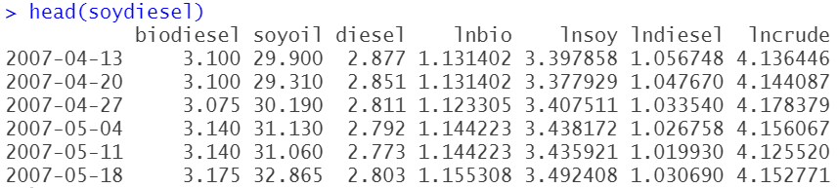
Data
Load data_lecture2.csv and do the data cleaning steps – same data as last week
Last week, we used price levels. Today, we will focus on log prices

Slide 5
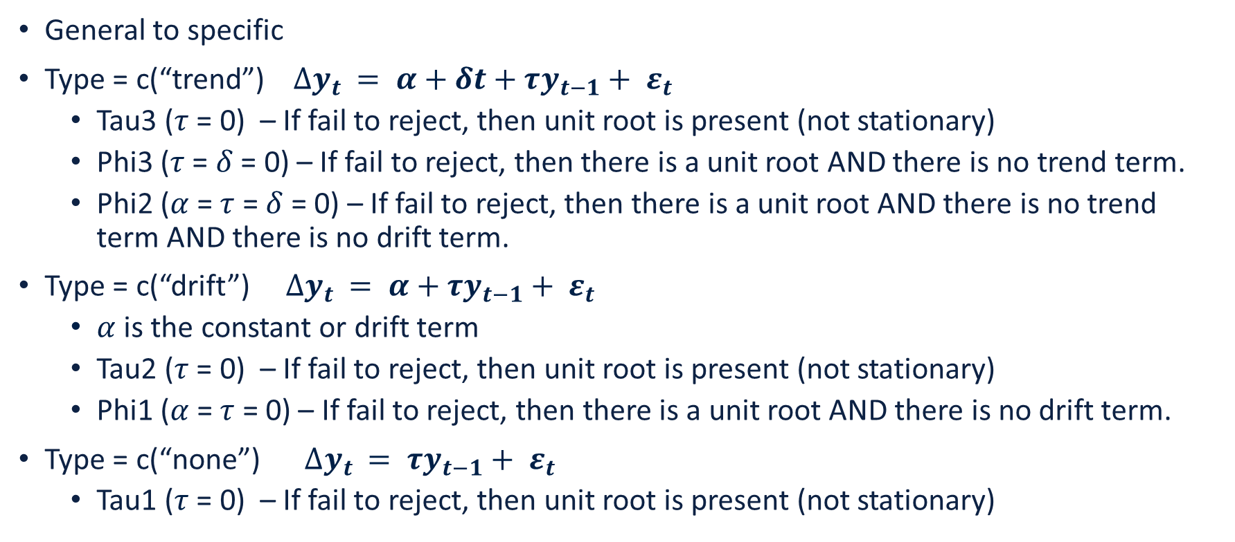
ADF Tests
General to specific
Type = c(“trend”) $∆y_{t }= α+δt+τy_{t−1}+ ε_{t}$
Tau3 ($τ$ = 0) – If fail to reject, then unit root is present (not stationary)
Phi3 ($τ$ =$δ$ = 0) – If fail to reject, then there is a unit root AND there is no trend term.
Phi2 ($α$ = $τ$ =$δ$ = 0) – If fail to reject, then there is a unit root AND there is no trend term AND there is no drift term.
Type = c(“drift”) $∆y_{t }= α+τy_{t−1}+ ε_{t}$
$α$ is the constant or drift term
Tau2 ($τ$ = 0) – If fail to reject, then unit root is present (not stationary)
Phi1 ($α$ = $τ$ = 0) – If fail to reject, then there is a unit root AND there is no drift term.
Type = c(“none”) $∆y_{t }= τy_{t−1}+ ε_{t}$
Tau1 ($τ$ = 0) – If fail to reject, then unit root is present (not stationary)

Slide 6
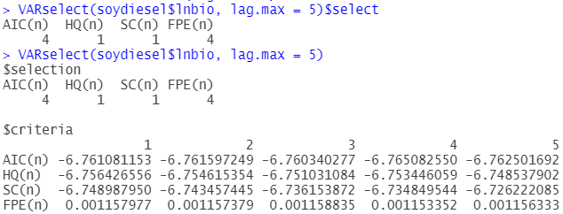
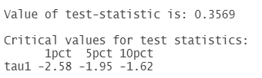
ADF Tests – Lag Length
VARselect(soydiesel$lnbio, lag.max = 5)$select

Slide 7
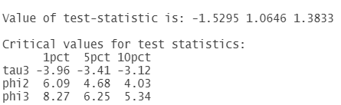
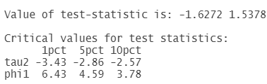
ADF Tests – Log Prices
summary(ur.df(soydiesel$lnbio, type = c("trend"), lags = 4))
summary(ur.df(soydiesel$lnbio, type = c("drift"), lags = 4))
summary(ur.df(soydiesel$lnbio, type = c("none"), lags = 4))

Slide 8
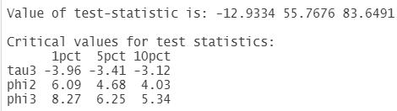
ADF Tests – First Difference
VARselect(diff.xts(soydiesel$lnbio, na.pad = F), lag.max = 5)$select
summary(ur.df(diff.xts(soydiesel$lnbio, na.pad = F), type = c("trend"), lags = 3))

Slide 9
Roadmap
Review - ADF Tests
Cointegration
Engle Granger 2 step test
Engle Granger function to retrieve correct critical values
Johansen Procedure
Error Correction Model

Slide 10
Engle Granger Method
We meet the necessary condition that prices in levels are I(1) and prices in first differences are I(0)
Step 1 – estimate the longrun relationship between biodiesel and soybean oil
Collect the residuals
Step 2 – run an ADF test on the residuals

Slide 11
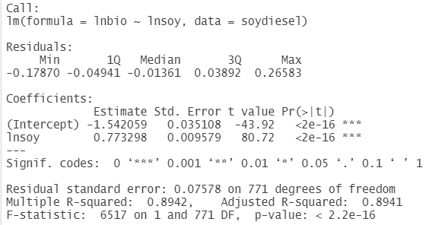
Engle Granger Method
Step 1 – estimate the longrun relationship between biodiesel and soybean oil
PBioDiesel_{t} = α + βPSoyoil_{t} + ε_{t}
reg_lnbiodieselsoy <- lm(lnbio ~ lnsoy, data = soydiesel)
summary(reg_lnbiodieselsoy)

Slide 12
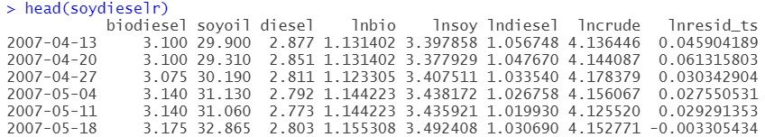
Engle Granger Method
Collect the residuals from the previous regression
In R, (1) save the residuals, (2) convert residuals to ts object, (3) merge to soydiesel
resid_lnsoydiesel <- resid(reg_lnbiodieselsoy)
lnresid_ts <- xts(resid_lnsoydiesel, order.by = index(soydiesel))
soydieselr <- merge.xts(soydiesel, lnresid_ts)
Will use this term later in ECM

Slide 13
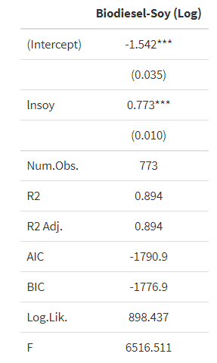
Format regression output
models <- list(
"Biodiesel-Soy (Log)" = lm(lnbio ~ lnsoy, data = soydiesel)
)
modelsummary(models, estimate = "{estimate}{stars}")

Slide 14
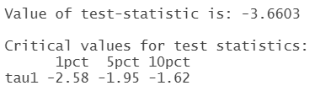
Engle Granger Method
Step 2 – run an ADF test for a unit root on the residuals
No need to use time trend or intercept because, by construction, the residuals will have a zero mean
If we reject the null hypothesis of a unit root, then we conclude that the two price series are cointegrated
VARselect(soydieselr$lnresid_ts)$select
summary(ur.df(soydieselr$lnresid_ts, type = c("none"), lags = 3))@teststat
Interpretation
It appears that we can reject the unit root null hypothesis
But this is not correct because we must use different critical values

Slide 15
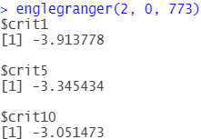
Engle Granger Method
Stata gives the correct critical values as part of the egranger test, but R does not
We wrote an R function that will give you the correct critical values
englegranger(var, trend, n)
var = # of variables, in our case 2 (biodiesel and soybean oil)
trend = 0 if no trend in step 1 regression, 1 if we included a trend in step 1 regression
n = number of observations = 773

Slide 16
Engle Granger Method
summary(ur.df(soydieselr$lnresid_ts, type = c("none"), lags = 3))@teststat
We must compare the t-statistic of -3.6603 with the critical values of -3.91 (1%), -3.34 (5%), -3.05 (10%). We can reject the null hypothesis of a unit root at the 5% level.
We have evidence that the biodiesel and soybean oil prices are cointegrated

Slide 17
Roadmap
Review - ADF Tests
Cointegration
Engle Granger 2 step test
Engle Granger function to retrieve correct critical values
Johansen Procedure
Error Correction Model

Slide 18
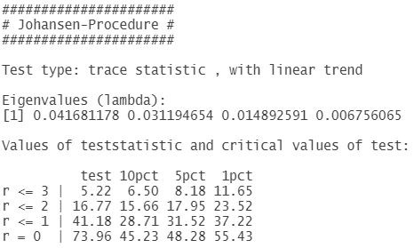
Testing for cointegration with multiple prices
jotest <- soydiesel[,c("lncrude", "lndiesel", "lnbio", "lnsoy")]
VARselect(jotest, lag.max = 10)
summary(ca.jo(jotest, type = c("trace"), ecdet = c("none"), K = 3, spec = c("transitory")))
Interpretation
We work from the bottom row to to top, and stop only when it is no longer possible to reject the null
r = 0 -> reject null of rank 0
r <=1 -> reject null of rank <=1
r <= 2 -> reject null at 90% confidence

Slide 19
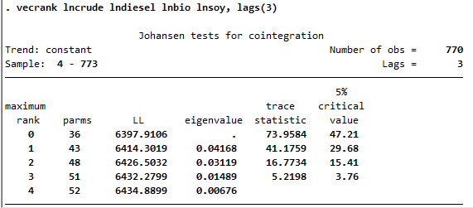
Testing for cointegration with multiple prices
Note that there is a difference in critical values across programs (read here and here for more info); trace statistic is the same though.
But the important thing is that we reject the null that there is no cointegrating relationship.

Slide 20
Roadmap
Review - ADF Tests
Cointegration
Engle Granger 2 step test
Engle Granger function to retrieve correct critical values
Johansen Procedure
Error Correction Model

Slide 21
Error Correction Model
So far we have established that
Biodiesel and soybean are are non-stationary
First difference of biodiesel and soybean oil are stationary, i.e. I(1)
Esimated PBioDiesel_{t} = α + βPSoyoil_{t} + ε_{t}
Collected the residuals and did an ADF test -> reject null hypothesis of a unit root
Biodiesel and soybean are cointegrated
We now want to investigate how quickly prices return to the long run equilibrium if one or both variables experience a shock – error correction model

Slide 22
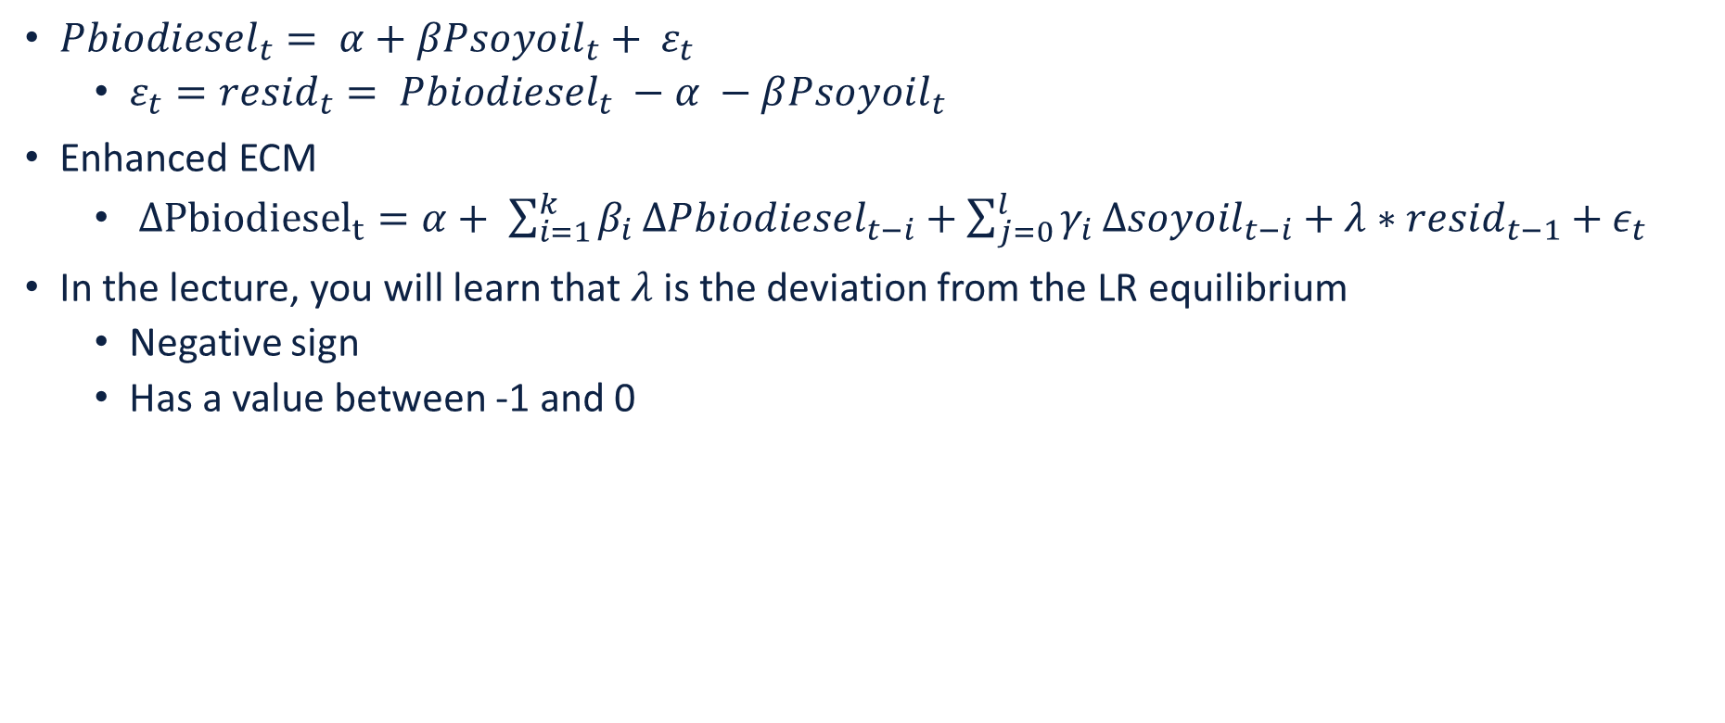
Error Correction Model
${Pbiodiesel}_{t}= α+{βPsoyoil}_{t}+ ε_{t}$
$ε_{t}={{resid}_{t}= Pbiodiesel}_{t} −α −β{Psoyoil}_{t}$
Enhanced ECM
$Δ{Pbiodiesel}_{t}=α+ \sum_{i=1}^{k}{β_{i}}Δ{Pbiodiesel}_{t−i}+\sum_{j=0}^{l}{γ_{i}}Δ{soyoil}_{t−i}+λ∗{resid}_{t−1}+ε_{t}$
In the lecture, you will learn that $λ$is the deviation from the LR equilibrium
Negative sign
Has a value between -1 and 0

Slide 23

Error Correction Model
Step Pre: Determine the optimal number of lags (i.e., k).
Step One: Regress $y_{t−1}$ on $x_{t−1}$ to estimate the long run relationship and then collect the residuals.
Or regress $y_{t}$ on $x_{t}$, save the residuals, and lag the residuals
Step Two: Estimate the general ECM with the appropriate number of lags.

Slide 24

Error Correction Model
Step Pre: Determine the optimal number of lags
VARselect(soydieselr$lnbio, lag.max = 5) -> 4 lags
VARselect(soydieselr$lnsoy, lag.max = 5) -> 1 lag
Step 1: regress $y_{t}$ on $x_{t}$, save the residuals, and lag the residuals
lag.xts(lnresid_ts)

Slide 25

Error Correction Model
Step Two: Estimate the general ECM with the appropriate number of lags.
ecm <- lm(diff.xts(lnbio, na.pad = T) ~
lag.xts(diff.xts(lnbio, na.pad = T)) +
lag.xts(lag.xts(diff.xts(lnbio, na.pad = T))) +
lag.xts(lag.xts(lag.xts(diff.xts(lnbio, na.pad = T)))) +
lag.xts(lag.xts(lag.xts(lag.xts(diff.xts(lnbio, na.pad = T))))) +
diff.xts(lnsoy, na.pad = T) +
lag.xts(diff.xts(lnsoy, na.pad = T)) +
lag.xts(lnresid_ts), data = soydieselr)
4 lags for biodiesel
Include ${Δx}_{t}$ -- see notes for discussion
1 lag for biodiesel
error correction term / speed of adjustment

Slide 26
Error Correction Model
New slide!!!
Step Two: Estimate the general ECM with the appropriate number of lags.
ecm1 <- lm(diff.xts(lnbio) ~
lag.xts(diff.xts(lnbio)) +
lag.xts(diff.xts(lnbio), k = 2) +
lag.xts(diff.xts(lnbio), k = 3) +
lag.xts(diff.xts(lnbio), k = 4) +
diff.xts(lnsoy) +
lag.xts(diff.xts(lnsoy), k = 1) +
lag.xts(lnresid_ts), data = soydieselr))
4 lags for biodiesel
Include ${Δx}_{t}$ -- see notes for discussion
1 lag for biodiesel
error correction term / speed of adjustment

Slide 27
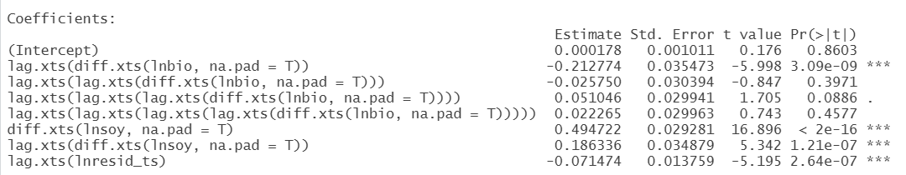
Error Correction Model

Slide 28
Summary
Review - ADF Tests
Cointegration
Engle Granger 2 step test
Engle Granger function to retrieve correct critical values
Johansen Procedure
Error Correction Model

